Slide 1

Kepler Data Analysis
Richard Anderson
Fork updates:
https://github.com/Rander417/KeplerExoplanet
New presentation
Raw data pulled from CSV initially
Pickled key data sets
Refactored all notebooks
Forked from team project:
https://github.com/tom-jj-G/KeplerExoplanets
Columbia University – Fu School of Engineering
Data Analytics 6mo Program
My role was building the ML pipeline
Data Cleaning
EDA
Preprocessing
Building the ML models
Teammates:
Damien Corr, Priscilla Lin, Tom Greff

Slide 2
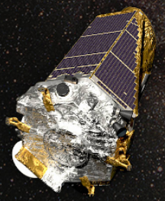
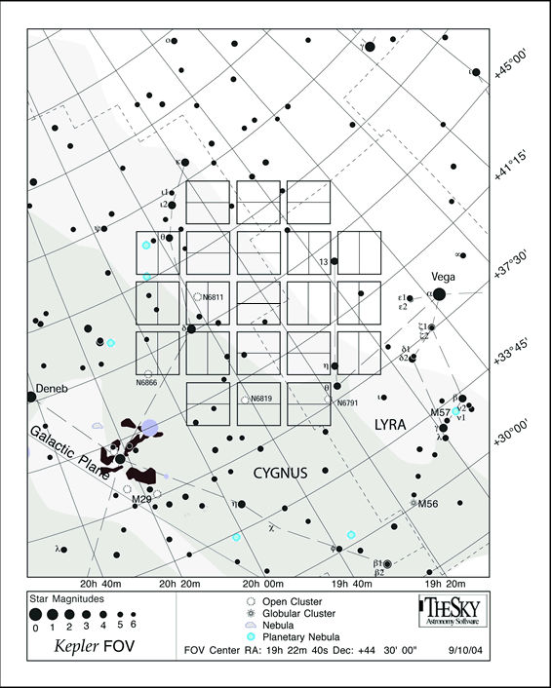
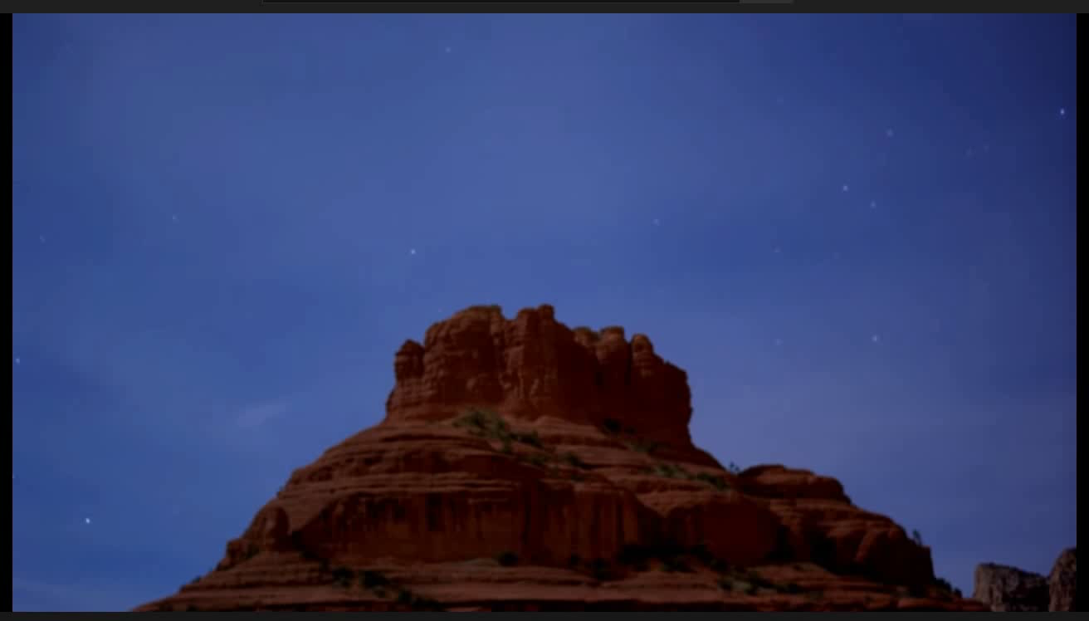
Kepler Mission Overview
Kepler Field of View (FOV)
“Designed to survey our region of the Milky Way galaxy to discover hundreds of Earth-size and smaller planets in or near the habitable zone and determine the fraction of the hundreds of billions of stars in our galaxy that might have such planets.”
https://www.nasa.gov/mission_pages/kepler/overview/index.html
The Kepler Telescope’s photometer consists of 21 CCD modules, each with two 2200x1024 pixel CCDs for a grand total of 94.6 million active pixels.
https://keplerscience.arc.nasa.gov/the-kepler-space-telescope.html#:~:text=entering%20the%20telescope.-,Field%20of%20view,during%20the%20prime%20Kepler%20mission
https://www.nasa.gov/mission_pages/kepler/overview/index.html

Slide 3
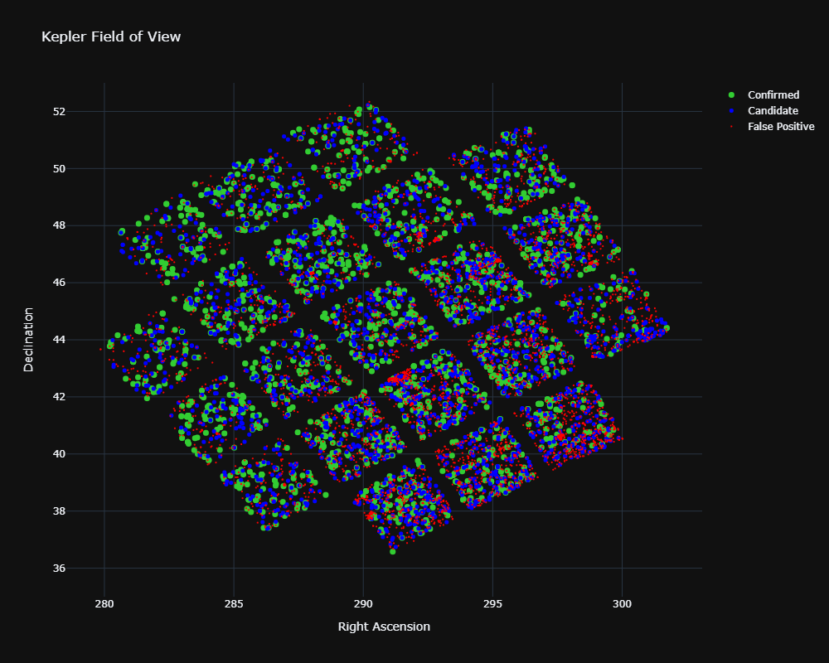
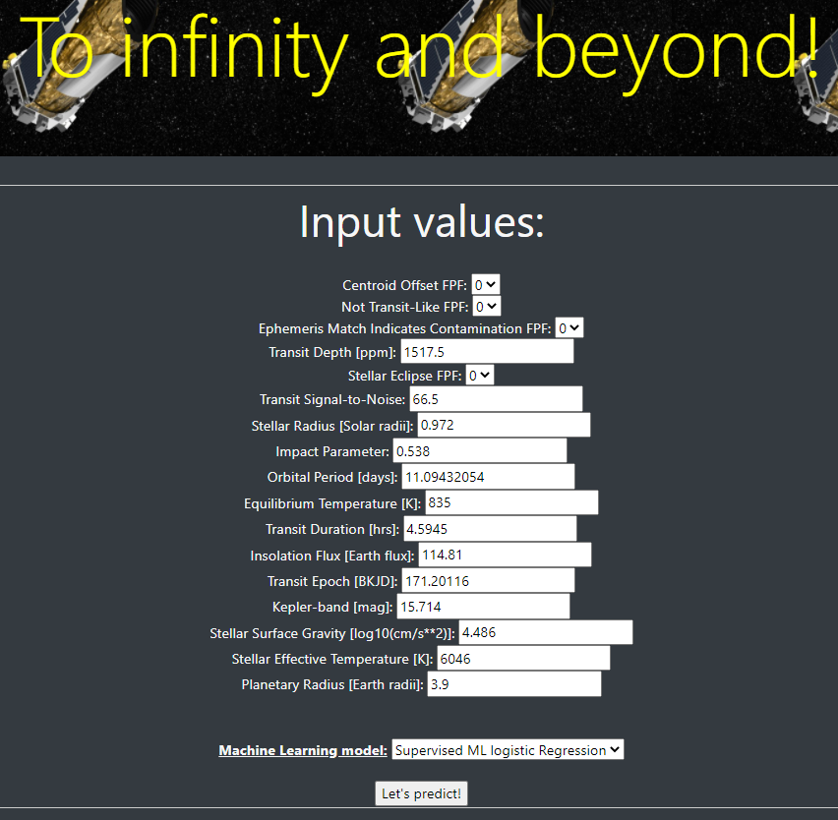
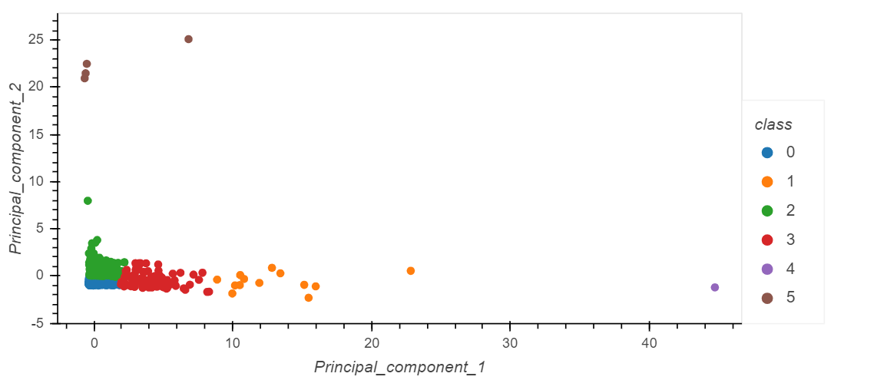
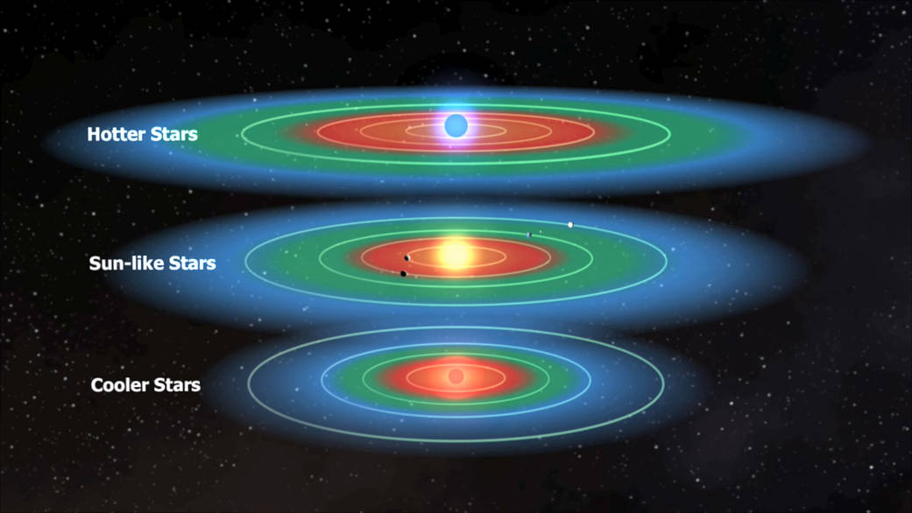
4 Big Questions
Is the Object of Interest an Exoplanet?
Can future observers use our models?
Does EDA reveal interesting groupings?
6 clusters found
Is the exoplanet in the habitable zone?
https://kepler-groupa.herokuapp.com/

Slide 4
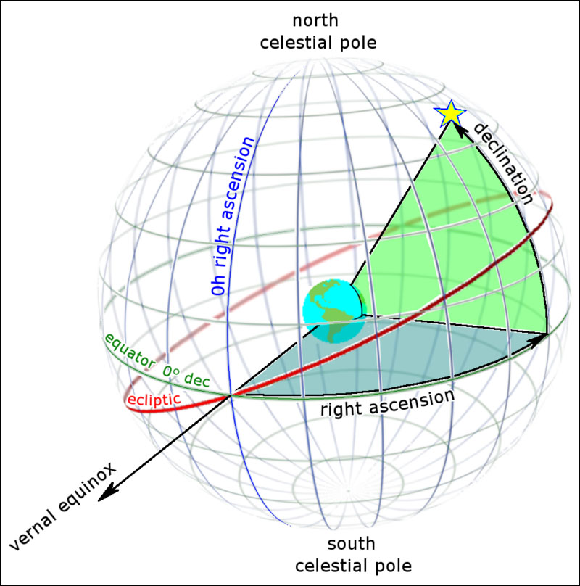
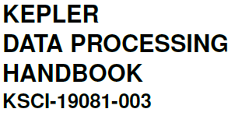
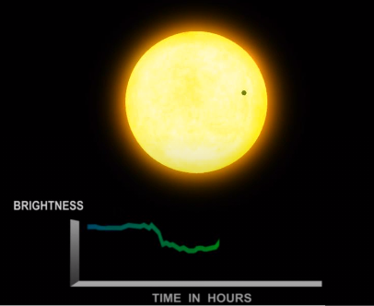
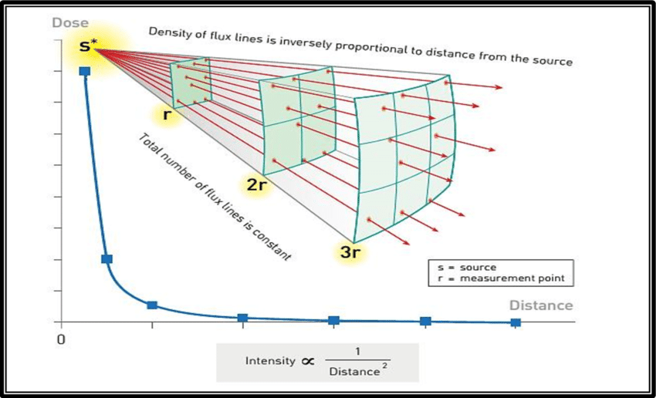
Domain knowledge
CHALLENGES
Astrophysics terminology
Cryptic acronyms & abbreviations
Koi_tce_delivname, koi_fpflag_nt...
Dense reference material
382 pages!
CELESTIAL COORDINATES
Declination corresponds to latitude &
Right Ascension to longitude
https://skyandtelescope.org/astronomy-resources/right-ascension-declination-celestial-coordinates/
TRANSIT
When one object crosses in front of another in space
FLUX
A star's apparent brightness
Transits by terrestrial planets produce a small change in a star's brightness of about 1/10,000 (100 parts per million, ppm), lasting for 2 to 16 hours.
https://exoplanets.nasa.gov/resources/1022/kepler-transit-graph/
https://bit.ly/2HBZvM3
https://bit.ly/34yWwNi

Slide 5
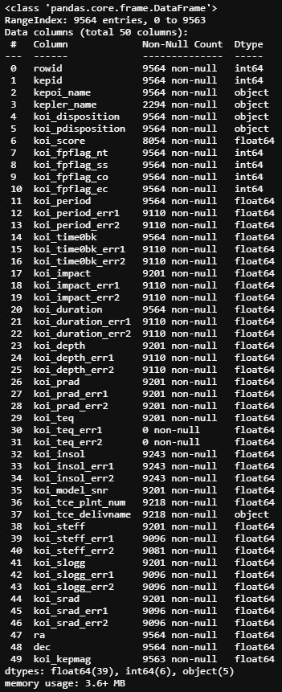
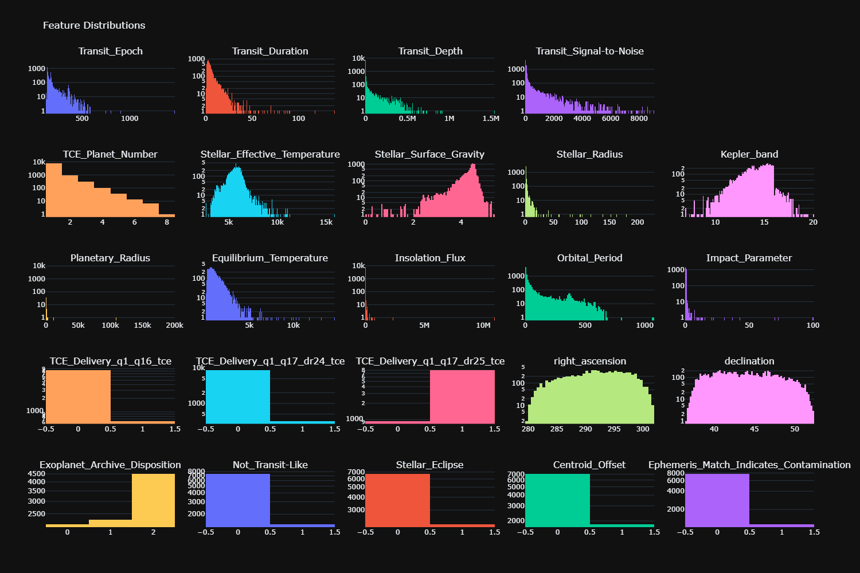
EDA & Preprocessing
Generally clean combination of numerical and categorical
Large number of nulls
Two Ys?!?
Unbalanced

Slide 6
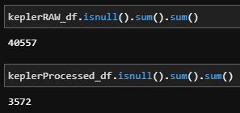
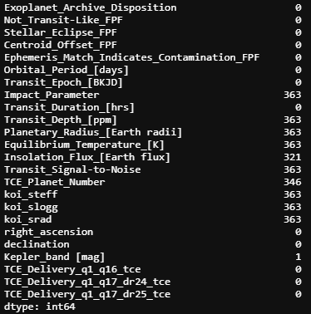
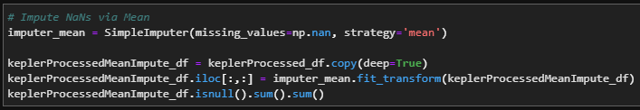
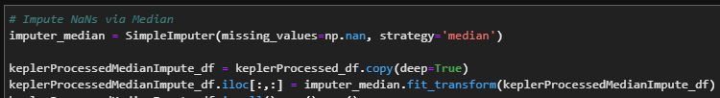
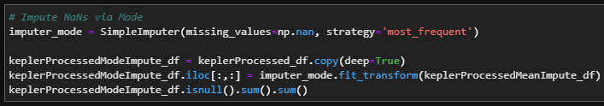
Handling Null Values
40k+ Null cells across 10k rows & 50 columns of data (500k cells)
363 rows with nulls after cleaning (including dropping +/- error columns)
We decided to drop the nulls due to their small volume & results of imputing
Impute methods evaluated:
Mean
Median
Mode
Mode had a negative f1 impact while Mean & Median had no discernable impact

Slide 7
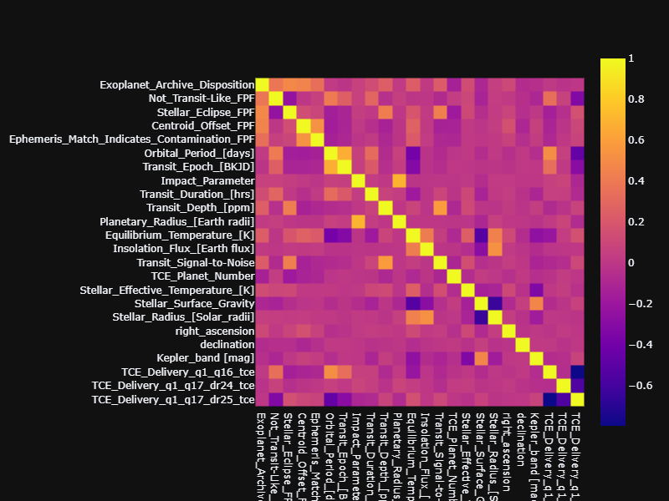
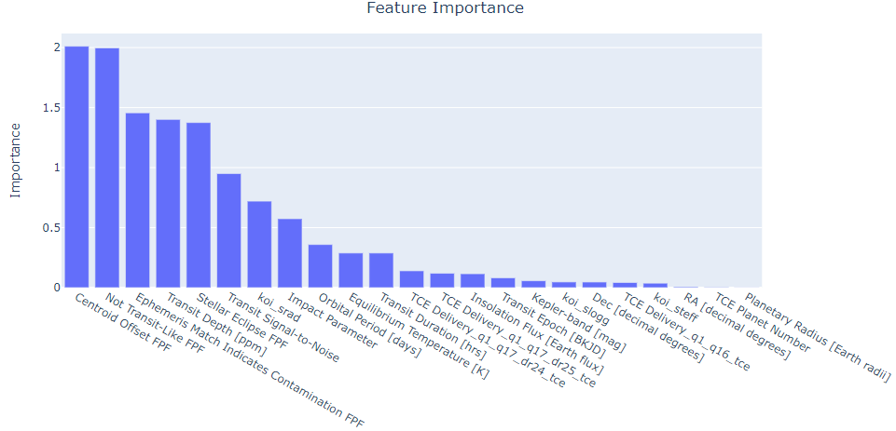
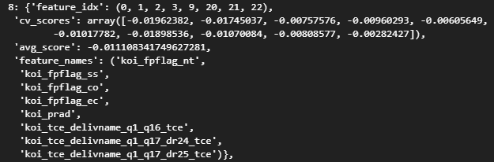
Feature Analysis & A Tale of Two Ys
Which target? Kepler Disposition vs Exoplanet Archive Disposition (EAD)
We chose EAD as it was the result of the most recent NASA analysis
ML models had a 99% f1 with kepler disposition
We analyzed our features using the methods below
"Sequential Feature Selection” is part of the mlxtend library - programmatically analyzes feature combinations
Correlation Matrix
Coefficient Graph
Sequential Feature Selection
Future options
Variance Inflation Factor
Multicollinearity
Lasso regression

Slide 8
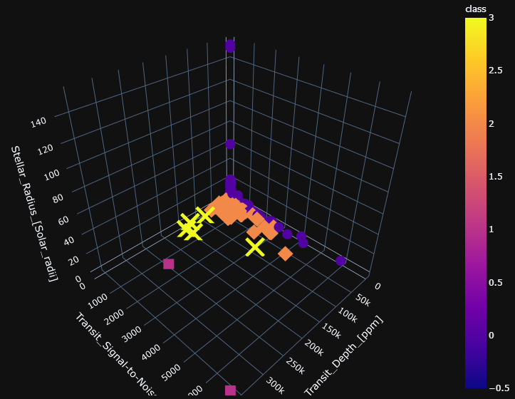
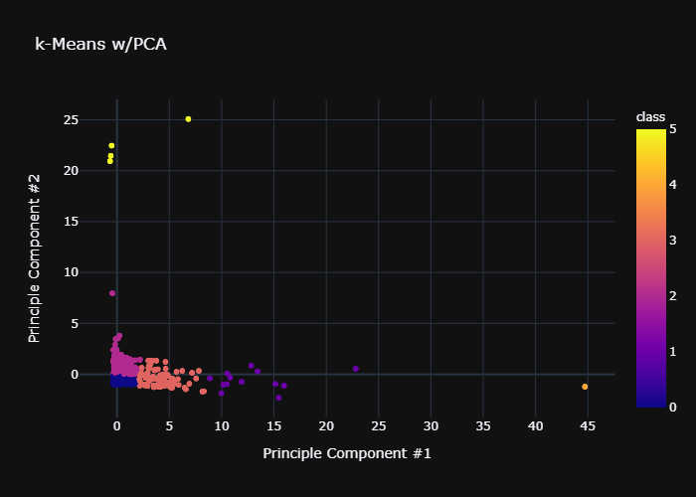
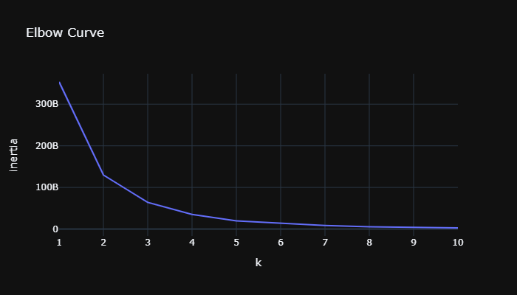
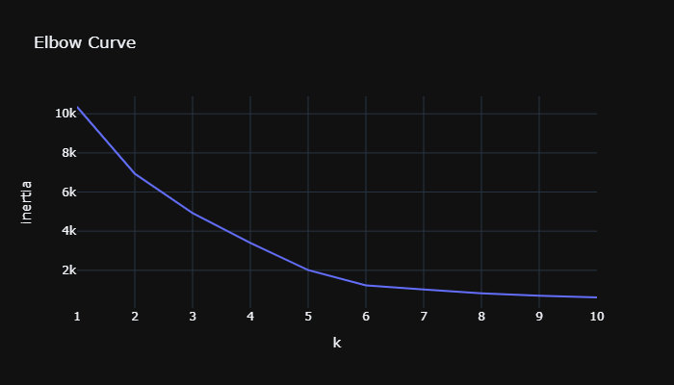
k-Means Clustering
elbow at 4
elbow at 6
For the three most important features, most objects have:
transit depth <20,000 parts/million
transit signal-to-lose <2000
stellar radius <20 solar radii
(6) clusters after using a new elbow curve
36% of the information is lost reducing four dimensions to two
Confirmation that most of the data is consistent/homogeneous

Slide 9
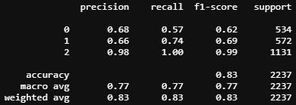
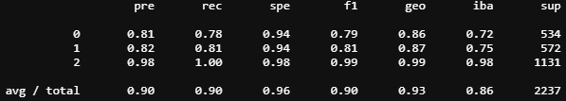
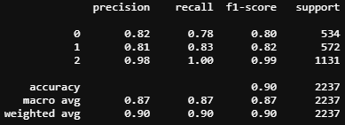
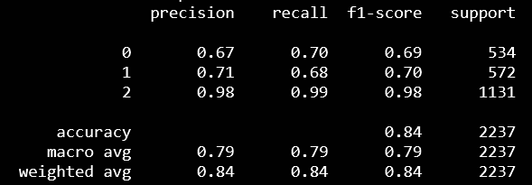
Supervised Machine Learning
LOGISTIC REGRESSION- 83% f1
Chosen since our questions are categorical
Weaker results likely due to unbalanced data
RANDOM FOREST- 90% f1
Alternative to better handle the data imbalance
GRADIENT BOOSTED TREES- 90% f1
Chosen to better handle the data imbalance
DEEP NEURAL NETWORK- 84% f1
Uses relu and softmax

Slide 10
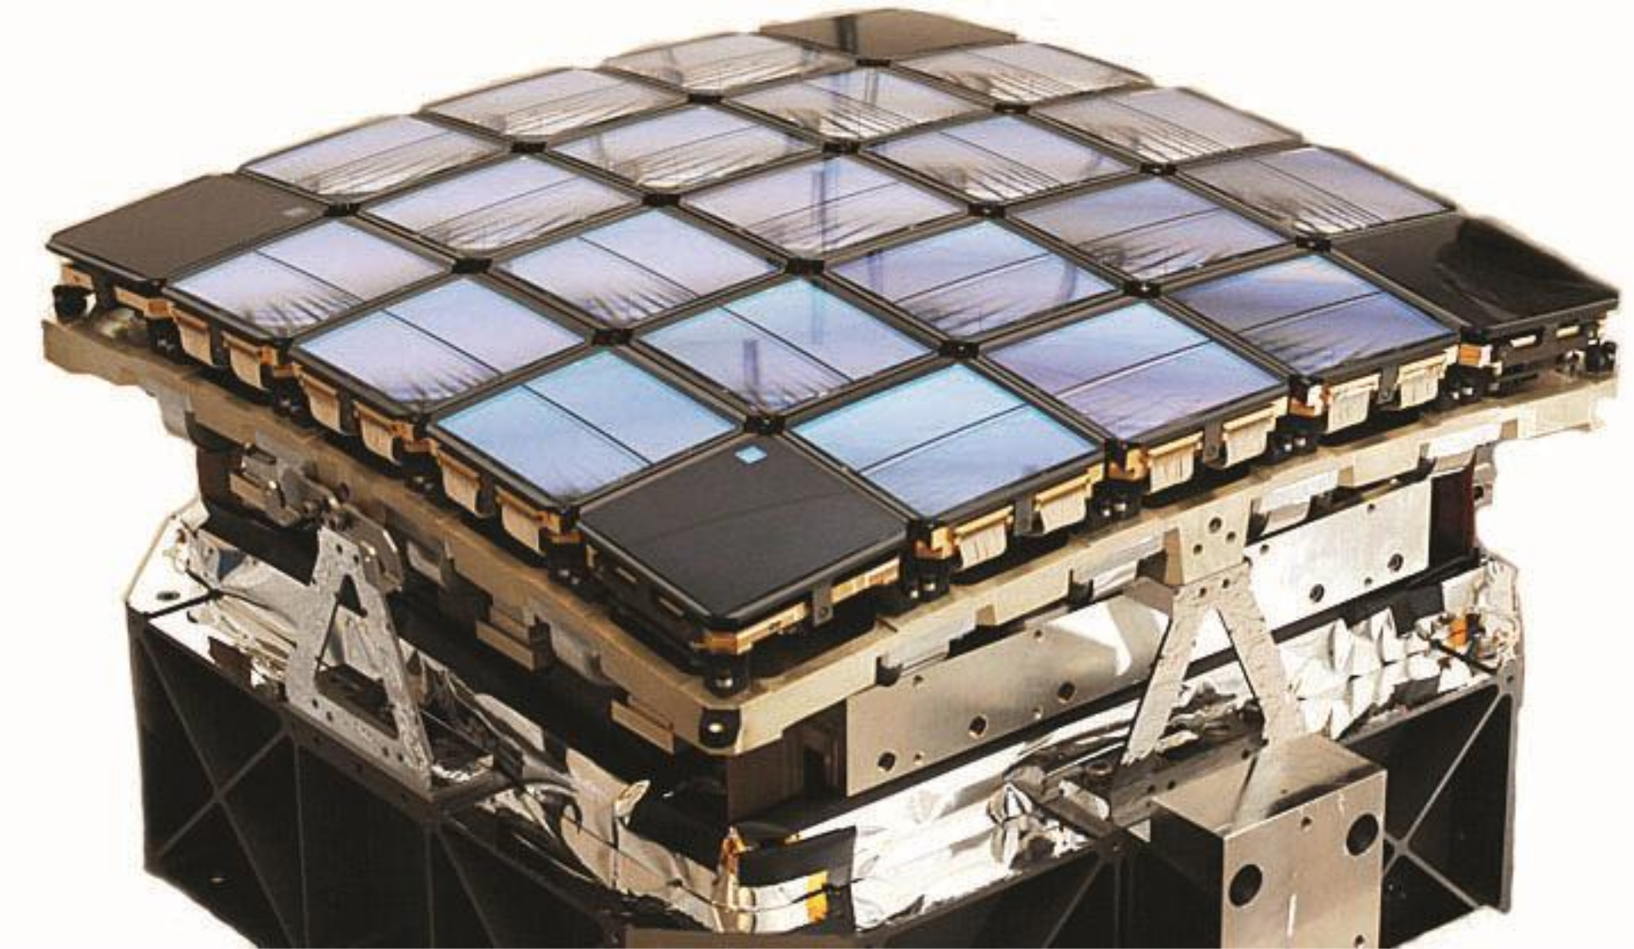
Graphing the results
Kepler Telescope’s Photometer

Slide 11
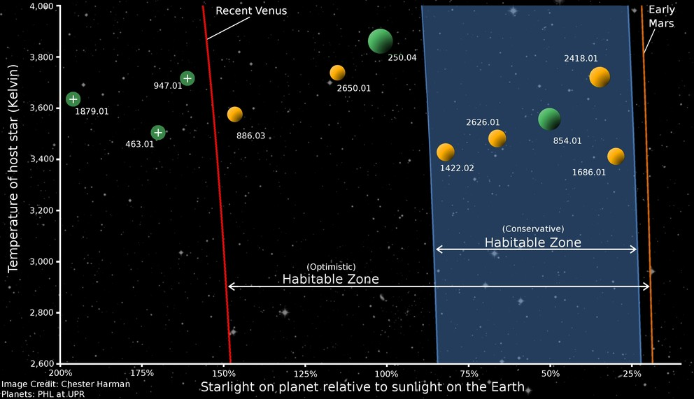
Habitable or Not? The Goldilocks Zone
Not too close…
…and not too far!

Slide 12
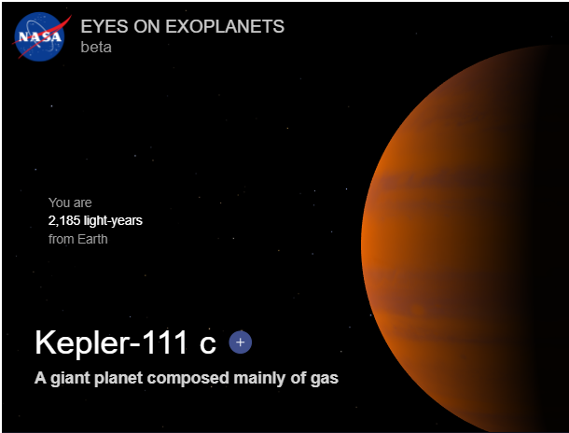
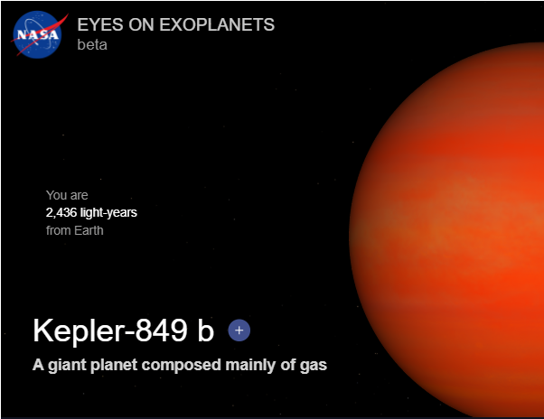
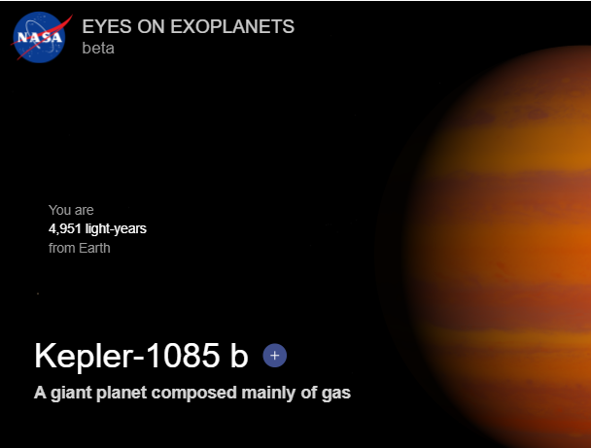
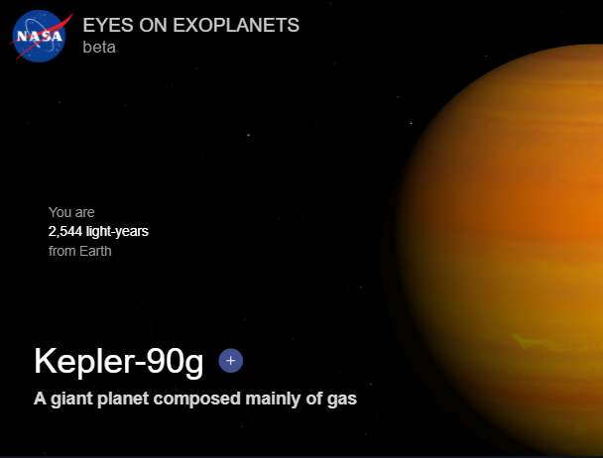
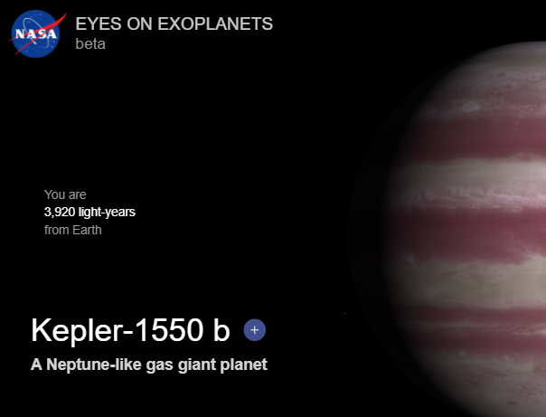
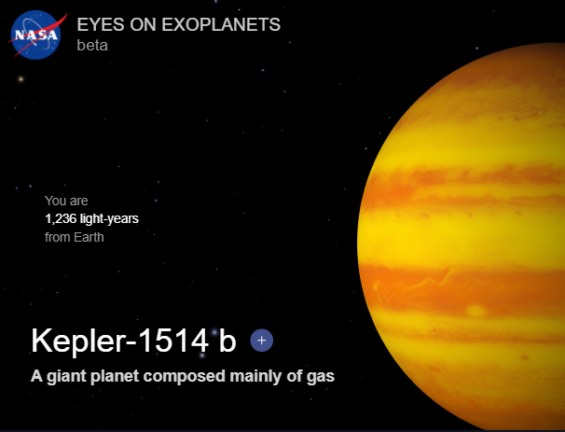
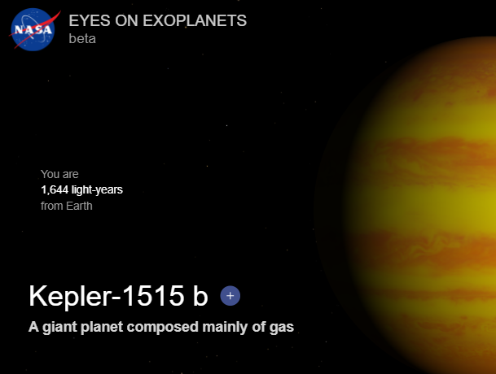

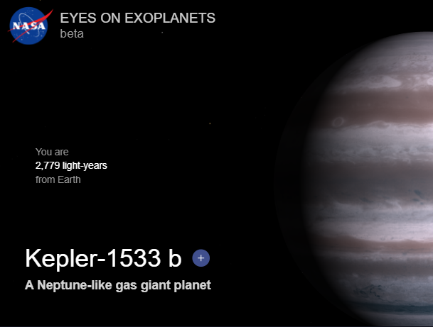
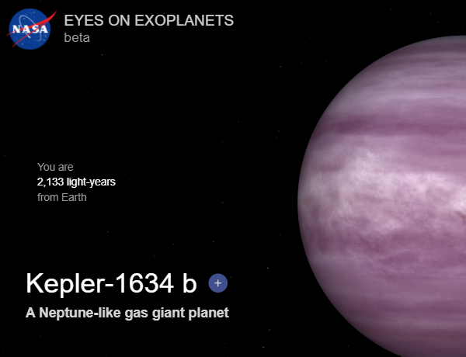
Is the Exoplanet in the Goldilocks Zone?
Habitable Criteria:
Orbital_period[days]: 200 ~ 400
Stellar_effective_temperature: > 5500 ~ 6500
Stellar_radius[solar_radii]: 1 ~ 2
Stellar_surface_gravity[log10(cm/s**2)]: > 4
Stellar_metallicity: > 0
Confirmed exoplanets: 2291
Habitable Zone: 12
Candidate Objects: 2186
Habitable Zone: 37
Image sources: https://exoplanets.nasa.gov/exoplanet-catalog/

Slide 13
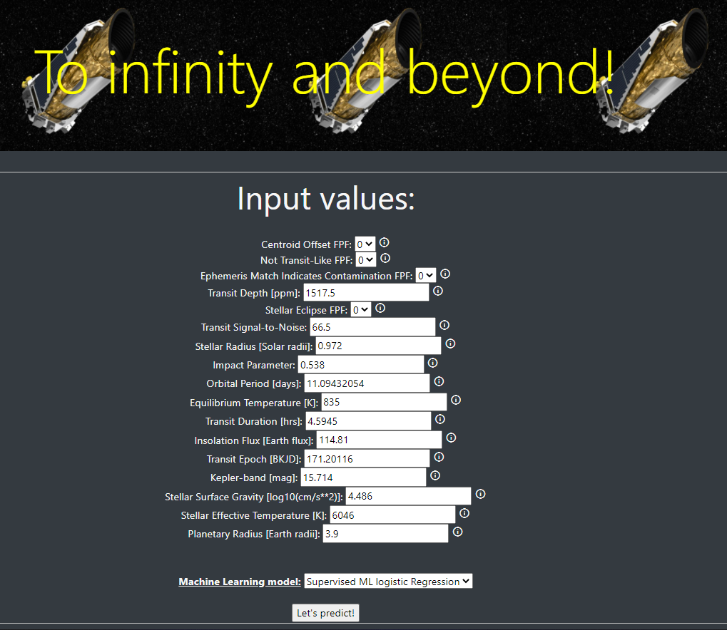
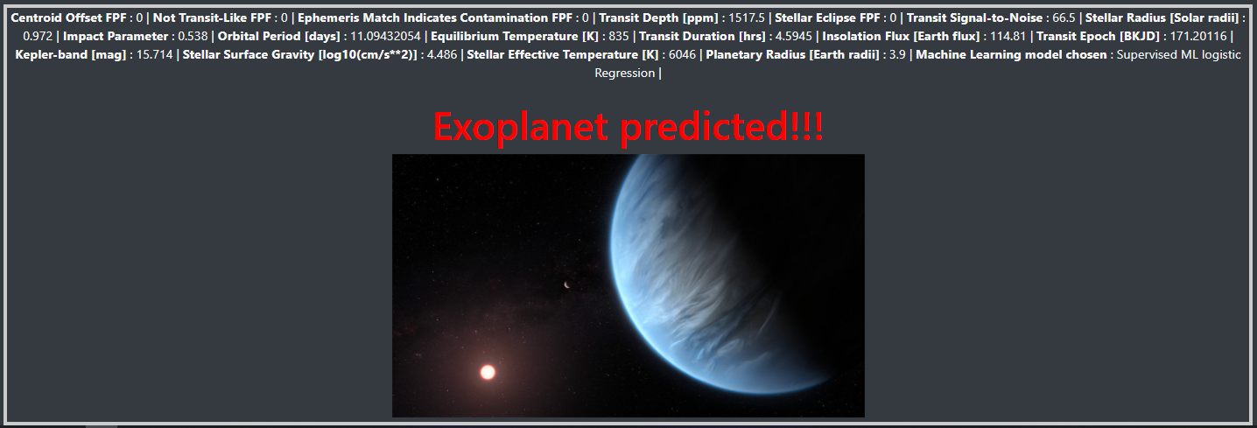
Prediction web-app
Takes new observations and predicts if the object is an exoplanet using our ML models
Built with ES6/HTML
Hosted online
https://kepler-groupa.herokuapp.com/

Slide 14














Technologies

Slide 15
APPENDIX

Slide 16
change-log
Back-end
Raw data pulled from CSV
Pickled key data sets for use across notebooks
Refactored all notebooks
All plots updated to plotly
Front-end
New presentation

Slide 17

Project Scope
BACK-END
FRONT-END
Exploratory Data Analysis
Handling nulls
Cluster analysis - refactor in progress
Visualizations
Machine Learning Models
Baseline
Feature selection
Tuning - refactor in progress
Presentation
Web App
Hosted on Heroko - refactor in progress
Preprocessing
Feature reduction
Conversion to numeric
Scaling
Habitable Zone analysis
Filtering Model results

